Slide 1


NETAJI SUBHAS UNIVERSITY OF TECHNOLOGY
Soft Computing (COCSC503)
Submitted By:
1. Kartik Jha (2024UCS1609)
2. Atharv Pratap Singh (2024UCS1610)
3. Anirudh Sreekumar Nair (2024UCS1619)
4. Bhagya Ranjan Singh (2024UCS2135)

Slide 2
Perceptron
x₁
Σ
Architecture • Training Rule • Decision Boundaries • Limitations
x₂
y
xₙ
Artificial Neural Networks / Soft Computing

Slide 3

What Is a Perceptron?
A single-layer neural network that learns to classify input values using adjustable weights and activation function.
Frank Rosenblatt (1957):
Frank Rosenblatt was an American scientist who introduced the perceptron in 1957. It was an early neural network model designed to learn from examples and perform pattern recognition, inspired by biological learning.
Warren McCulloch and Walter Pitts (1943):
They proposed a mathematical model of an artificial neuron using binary outputs and a threshold function. Its connection parameters were fixed rather than automatically learned from training data.

Slide 4
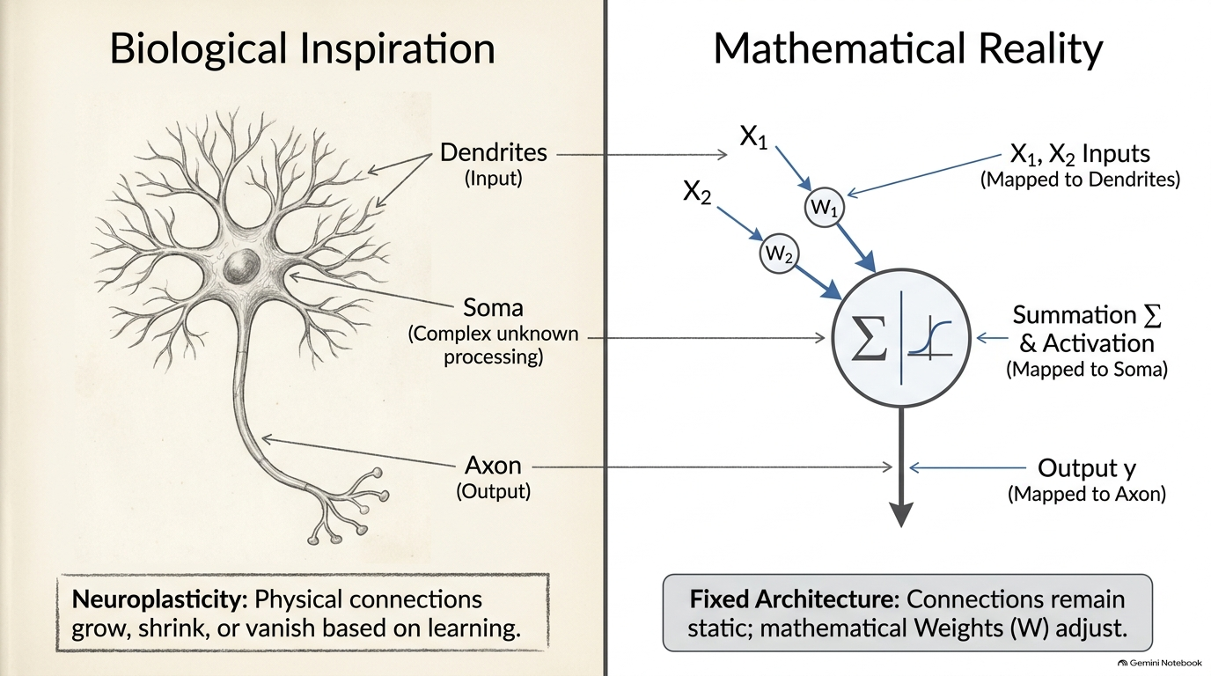

Slide 5
Understanding the Perceptron: Key Concepts
1. Perceptron Architecture
How inputs, weights and bias are combined to produce an output.
The step activation function determines the predicted class.
2. Training Rule
The model compares its predicted output with the desired output.
Weights and bias are updated to correct classification errors.
3. Decision Boundaries
Weights determine the orientation of the boundary, while bias shifts its position.
The boundary separates the input space into different classes.
4. Limitations of the Perceptron
A single-layer perceptron can classify linearly separable data.
It cannot solve non-linearly separable problems such as XOR.

Slide 6
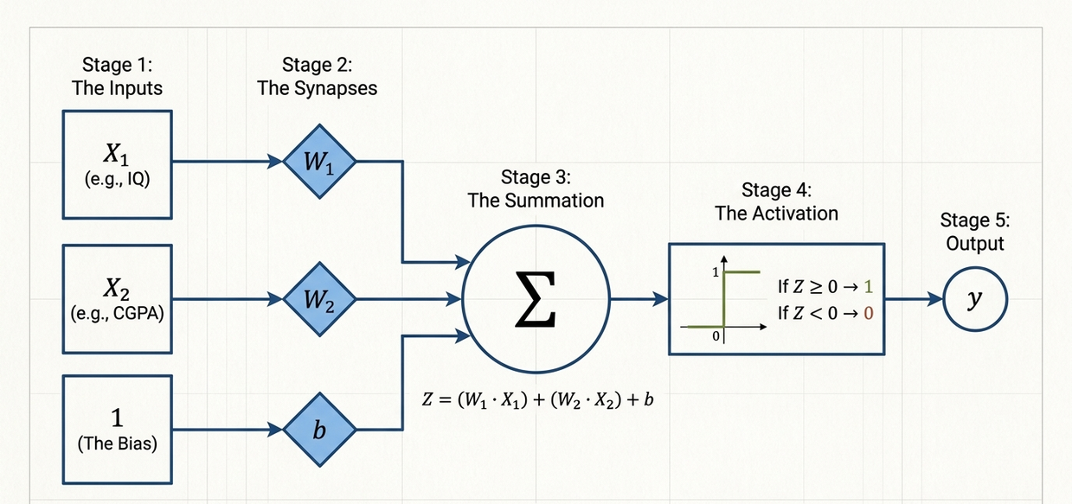
Perceptron Architecture
1
Input units
receive features x₁ … xₙ
2
Weights
set each input's contribution
Weights & bias
3
Summation
computes the weighted sum
4
Bias
shifts the decision boundary
5
Activation
turns net input into a class
6
Output
predicted class, 0 or 1

Slide 7
WEIGHT AND BIAS
Weight Sign Meaning
Positive Weight (w_{i} > 0): Increasing feature value x_{i} increases z, driving prediction toward positive class ŷ = 1.
Negative Weight (w_{i} < 0): Increasing feature value x_{i} decreases z, pulling prediction toward negative class ŷ = 0.
A weight is a numerical value assigned to each input that determines how much that input contributes to the perceptron's final output.
Bias is an extra value added to the weighted sum that helps adjust the perceptron's decision threshold. It allows the decision boundary to shift instead of being forced to pass through the origin.

Slide 8
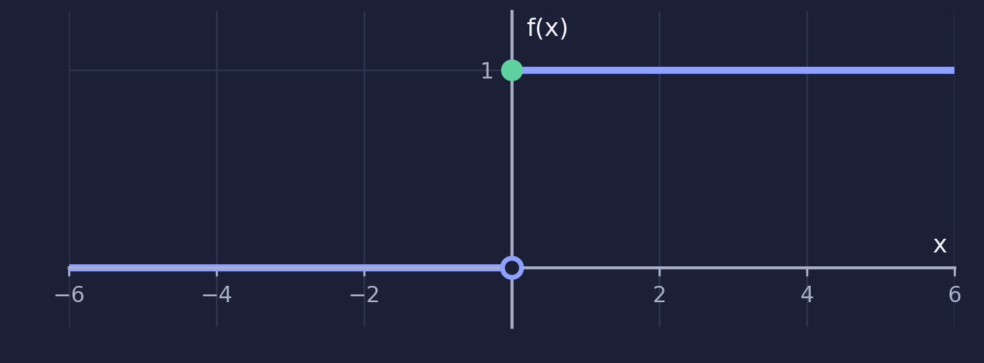
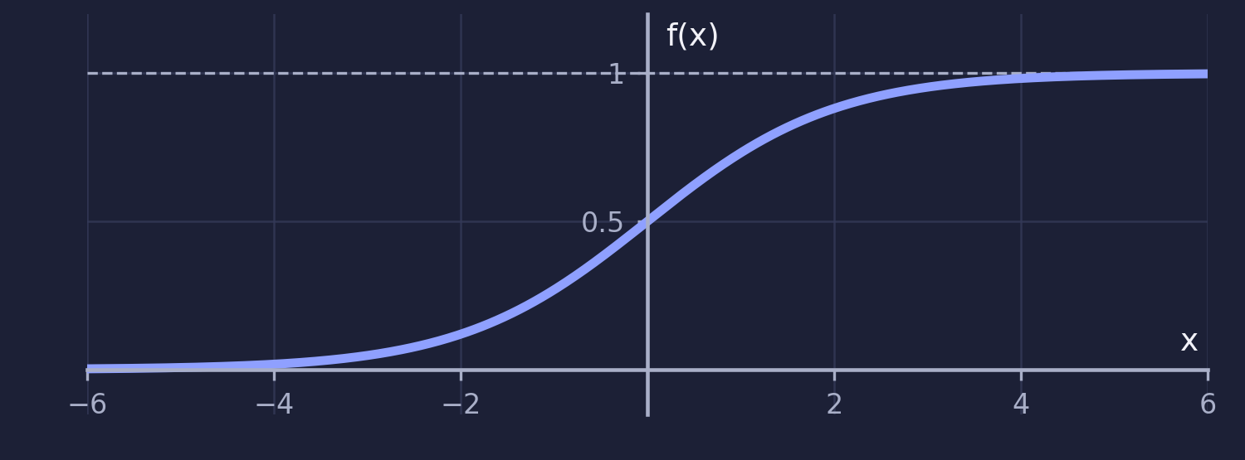
ACTIVATION FUNCTIONS
1
Step Function
f(x) = 1 if x ≥ 0; f(x) = 0 if x < 0
2
Sigmoid Function
f(x) = 1 / (1 + e^{−x})
Definition: Outputs 1 when the input is ≥ 0, otherwise 0.
Uses: Classic perceptron; Yes/No decisions.
Advantage: Simple, fast and easy to understand.
Disadvantage: Zero gradient, so no gradient-based learning.
Definition: Squashes any input into a value between 0 and 1.
Uses: Binary classification outputs; probability-like scores.
Advantage: Smooth curve; output reads like a probability.
Disadvantage: Vanishing gradients for very large |x|.

Slide 9
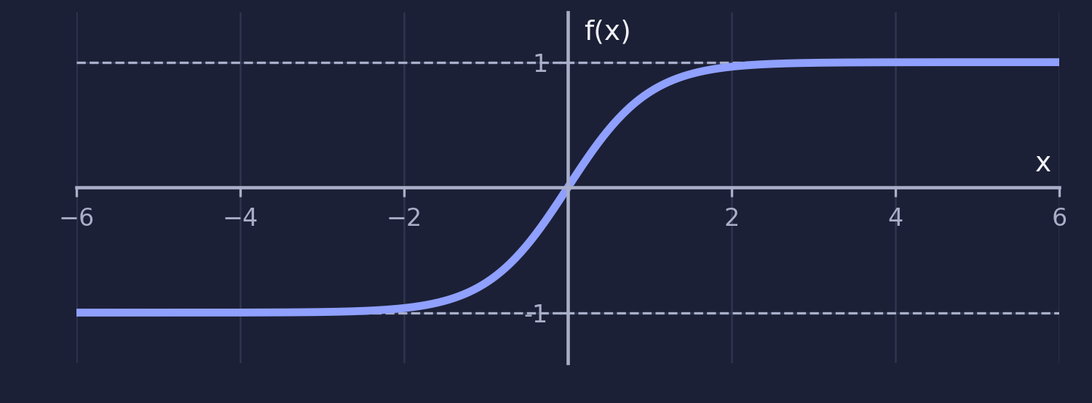
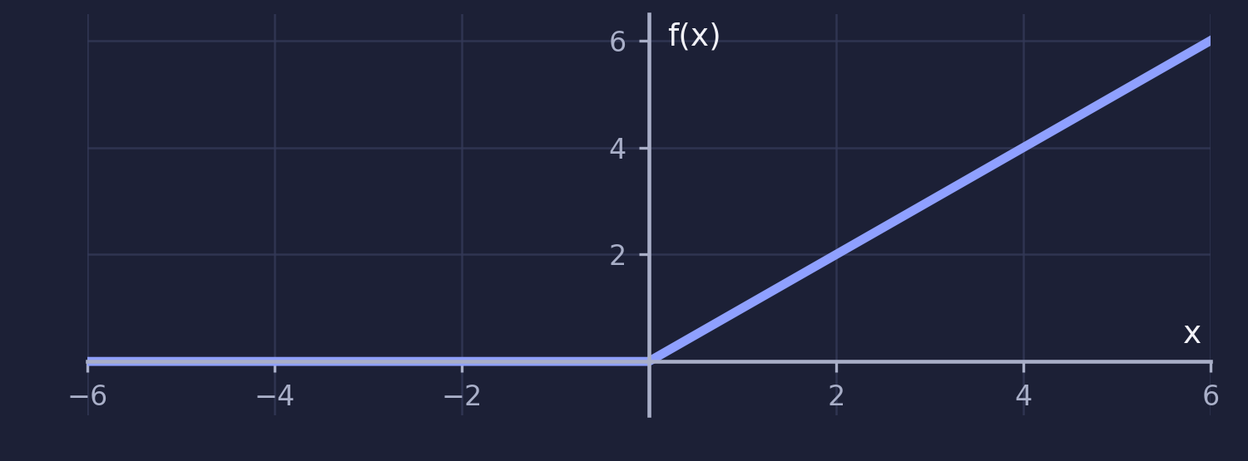
ACTIVATION FUNCTIONS
3
Tanh Function
f(x) = (e^{x} − e^{−x}) / (e^{x} + e^{−x})
4
ReLU (Rectified Linear Unit)
f(x) = max(0, x)
Definition: Squashes any input into a value between −1 and 1.
Uses: Hidden layers; recurrent neural networks.
Advantage: Zero-centered output helps learning.
Disadvantage: Vanishing gradients for large |x|.
Definition: 0 for negative inputs, x for positive inputs.
Uses: Hidden layers of deep neural networks.
Advantage: Cheap to compute; eases vanishing gradients.
Disadvantage: Dying ReLU: neurons can get stuck at 0.

Slide 10
Worked Example: Student Classification (INFERENCE)
1
Input features
IQ = 120 → Input x₁ = 120
CGPA = 8.5 → Input x₂ = 8.5
2
Weights and Bias after training
w₁ = 0.01, w₂ = 0.1
b = −2
3
Calculate the weighted sum
z = w₁x₁ + w₂x₂ + b
z = (0.01)(120) + (0.1)(8.5) − 2
z = 1.2 + 0.85 − 2 = 0.05
4
Apply the step activation function
Since z = 0.05 ≥ 0,
y = 1
Prediction
Placement = Yes (Class 1)

Slide 11
Training Algorithm
Initialize weights and bias
1
Initialize to zeros or small random values because no complex algorithm is required, the Perceptron Convergence Theorem guarantees the model will converge to the correct weights anyway if the data is linearly separable
2
Pick a labelled pattern
pick a single input vector (the pattern) and its correct output (the label) from your training dataset
3
Compute z = Σ wᵢxᵢ + b
Calculates the total net value by summing up the combined influences of all inputs before passing the result to the activation function. ( note – perceptron convergence theorem )

Slide 12
4
Compute y with the step function
The raw weighted sum is sent into activation function , which outputs the final binary classification.
5
Process all patterns (one epoch)
Evaluate the entire dataset at the end of the epoch to check total classification errors.
6
Update weights
Update weights using either perceptron trick or loss function with gradient descent
7
Stop Training
Stop training when the model achieves zero classification errors or reaches the maximum allowed number of epochs.

Slide 13
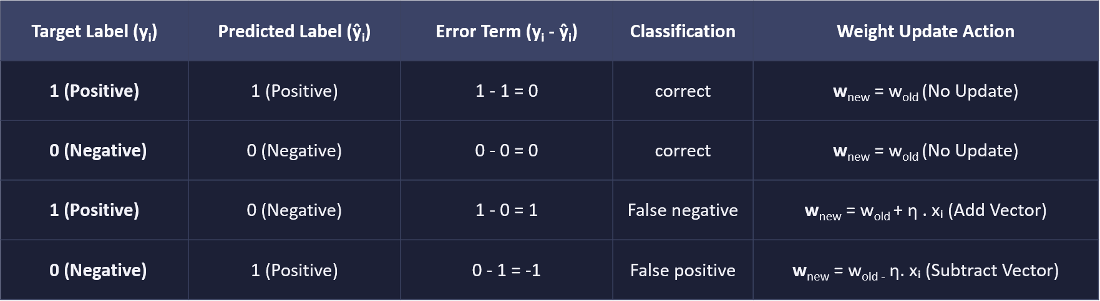
Update weights and Bias using perceptron trick
η : learning rate y_{i} : desired output
ŷᵢ : predicted output xᵢ : input value
The bias has no xᵢ term: it acts as a weight on a constant input of 1.
Weight update : w_{new} = w_{old} + η × (yᵢ − ŷᵢ) . xᵢ
Bias update : b_{new} = b_{old} + η × (yᵢ − ŷᵢ)

Slide 14

Update weights and Bias using loss function
What Is Loss and Why Do We Use It ?
Loss is a numerical measure of how incorrectly a perceptron classifies the training data.
It helps measure the errors made by the model, and the objective of training is to minimize the total loss.
Perceptron Loss Function
Formula:
$$\boxed{ L =\frac{1}{N}\sum_{i=1}^{N}{max}\left(0 , −y_{i}f\left(x_{i}\right)\right)}$$
Where:
L = Average loss over the training dataset
N = Total number of training samples
yᵢ = True label (+1 or −1)
f(xᵢ) = Model's prediction value
max(0, …) = Ensures that correctly classified samples have zero loss under this formula.

Slide 15
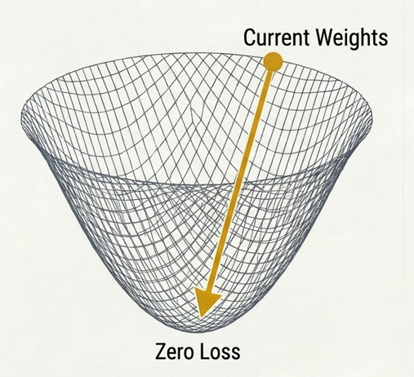
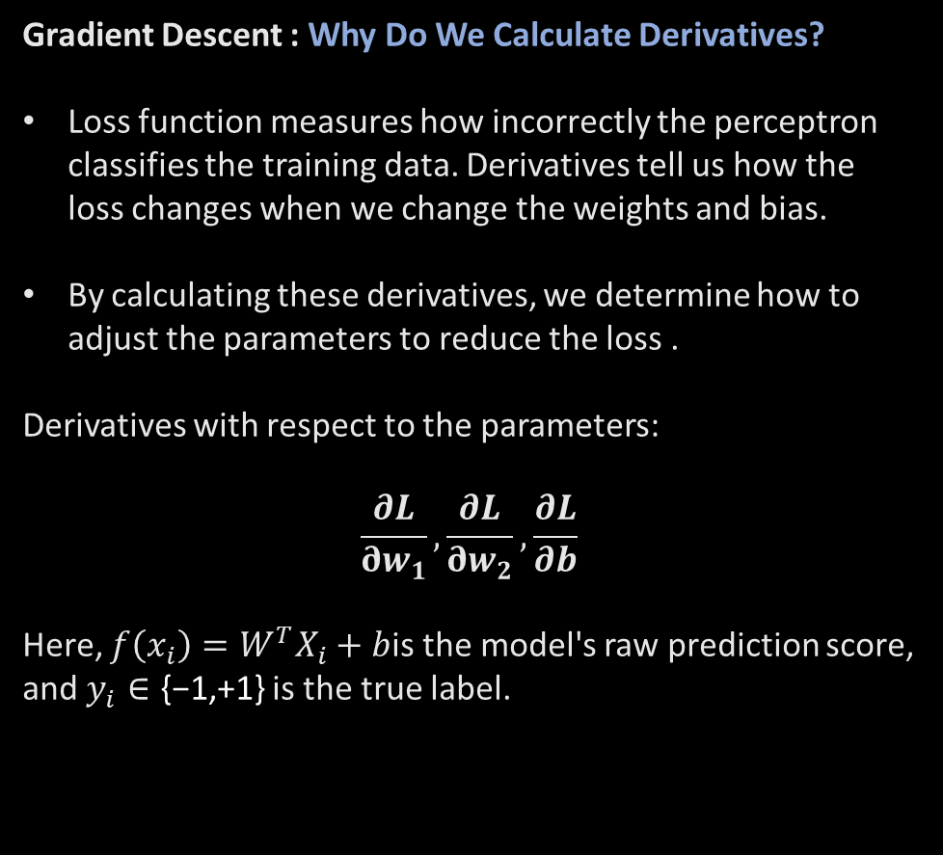
The Optimizaton engine : Gradient Descent
Gradient Descent : Why Do We Calculate Derivatives?
Loss function measures how incorrectly the perceptron classifies the training data. Derivatives tell us how the loss changes when we change the weights and bias.
By calculating these derivatives, we determine how to adjust the parameters to reduce the loss .
Derivatives with respect to the parameters:
$$\frac{∂L}{∂w_{1}}, \frac{∂L}{∂w_{2}}, \frac{∂L}{∂b}$$
Here, $f\left(x_{i}\right)=W^{T}X_{i}+b$is the model's raw prediction score, and $y_{i}∈\text{\{−1,+1\}}$is the true label.

Slide 16
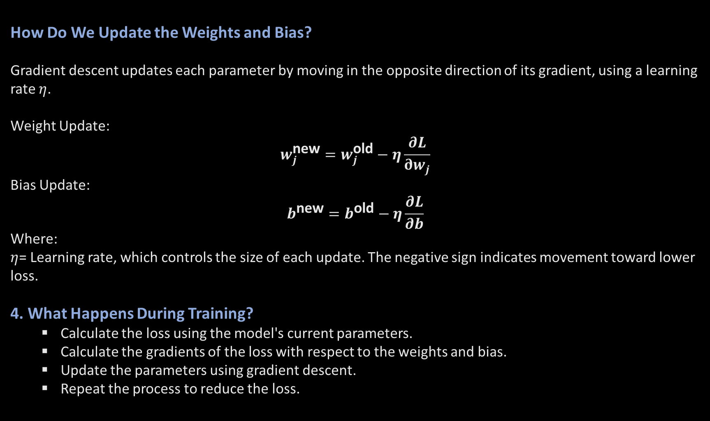
How Do We Update the Weights and Bias?
Gradient descent updates each parameter by moving in the opposite direction of its gradient, using a learning rate $η$.
Weight Update:
$$w_{j}^{\text{new}}=w_{j}^{\text{old}}−η\frac{∂L}{∂w_{j}}$$
Bias Update:
$$b^{\text{new}}=b^{\text{old}}−η\frac{∂L}{∂b}$$
Where:
$η$= Learning rate, which controls the size of each update. The negative sign indicates movement toward lower loss.
4. What Happens During Training?
  Calculate the loss using the model's current parameters.
  Calculate the gradients of the loss with respect to the weights and bias.
  Update the parameters using gradient descent.
  Repeat the process to reduce the loss.

Slide 17
What Are Decision Boundaries?
A decision boundary separates the regions of input space assigned to different classes.
x₂
Z ≥ 0 → 1
w₁x₁ + w₂x₂ + b = 0
For a perceptron, the boundary is where net = 0.
(0,1)
(1,1)
AND: w = (1, 1), b = −1.5
x₁ + x₂ − 1.5 = 0 or x₂ = 1.5 − x₁
Z ≥ 0 → class 1; Z < 0 → class 0
(0,0)
(1,0)
x₁
Z < 0 → 0
Figure 2. A linear boundary separates the AND classes

Slide 18
Partitioning Space: Positive vs. Negative Half-Spaces
Positive Half-Space
Decision Boundary
Negative Half-Space
Condition: z = W^{T} X + b > 0
Activation Result: f(z) = 1
Predicted Label: ŷ = +1 (or 1)
Geometric Region: Space located on the side pointed to by weight vector W.
Condition: z = W^{T} X + b = 0
Activation Result: f(0) = 1 (or threshold boundary)
Predicted Label: Boundary Frontier
Geometric Region: Locus of all points lying exactly on decision line/hyperplane.
Condition: z = W^{T} X + b < 0
Activation Result: f(z) = 0
Predicted Label: ŷ = 0 (or -1)
Geometric Region: Space located opposite to direction vector W.

Slide 19
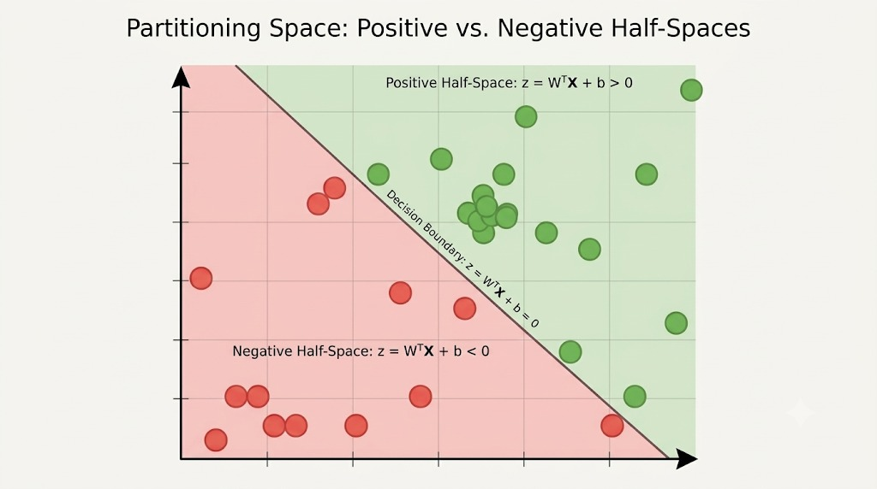

Slide 20
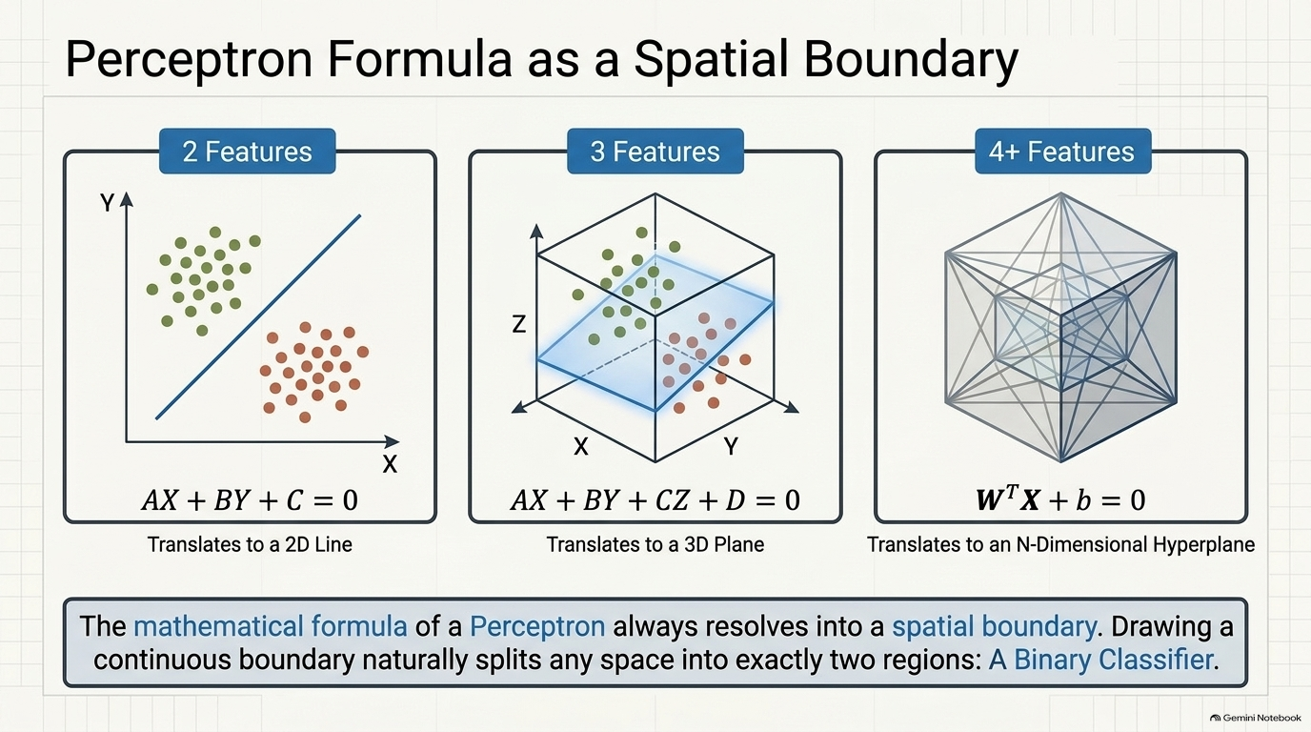
Boundaries in Different Dimensions
1
input
2
3
n > 3
inputs
inputs
inputs
Point
Line
Plane
Hyperplane
w₁x₁ + b = 0
w₁x₁+w₂x₂+b = 0
w₁x₁ + w₂x₂ + w₃x₃ + b = 0
Σ wᵢxᵢ + b = 0
Weights
control the orientation of the boundary
Bias
shifts the position of the boundary

Slide 21
How weights and bias change the boundary
Bias change = parallel shift
Weight change = rotation
x₂
x₂
x₁
x₁
same slope, different b
slope changes with w₁ / w₂
Translation (Shifting Bias)
Mathematical Action: Updating bias term b_{new} = b_{old} + η × (yᵢ − ŷᵢ)
Geometric Effect: Translates decision line parallelly across feature space.
Slope Impact: Line slope m = -w₁/w₂ remains completely unchanged.
Purpose: Shifts line closer or further from origin to encompass offset data clusters.
Rotation (Modifying Weights)
Mathematical Action: Updating weight values w_{new} = w_{old} + η × (yᵢ − ŷᵢ) . xᵢ
Geometric Effect: Rotates decision line by altering line orientation angle.
Slope Impact: Directly alters line slope m = -w₁/w₂
Purpose: Aligns boundary angle to match data distribution split direction.

Slide 22
The Geometric Perceptron Trick: Pulling & Pushing the Line
Case A: Positive Point Misclassified in Negative Region
Case B: Negative Point Misclassified in Positive Region
Case C: Correctly Classified Point
Situation: Actual class y_{i} = +1, but model predicted ŷ_{i} = 0 (z < 0).
Geometric Goal: Pull decision line TOWARD misclassified positive point.
Adjustment: Add point coordinates to weight vector (W_{new} = W_{old} + X_{i}).
Situation: Actual class y_{i} = 0, but model predicted ŷ_{i} = 1 (z > 0).
Geometric Goal: Push decision line AWAY from misclassified negative point.
Adjustment: Subtract point coordinates from weight vector (W_{new} = W_{old} - X_{i}).
Situation: Predicted label matches actual class label (ŷ_{i} = y_{i}).
Geometric Goal: Maintain current line position unchanged.
Adjustment: Zero parameter update (W_{new} = W_{old} ).

Slide 23
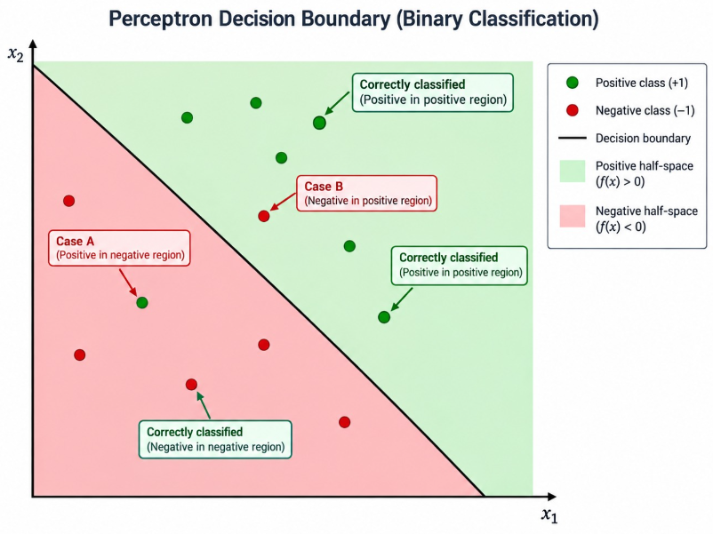

Slide 24
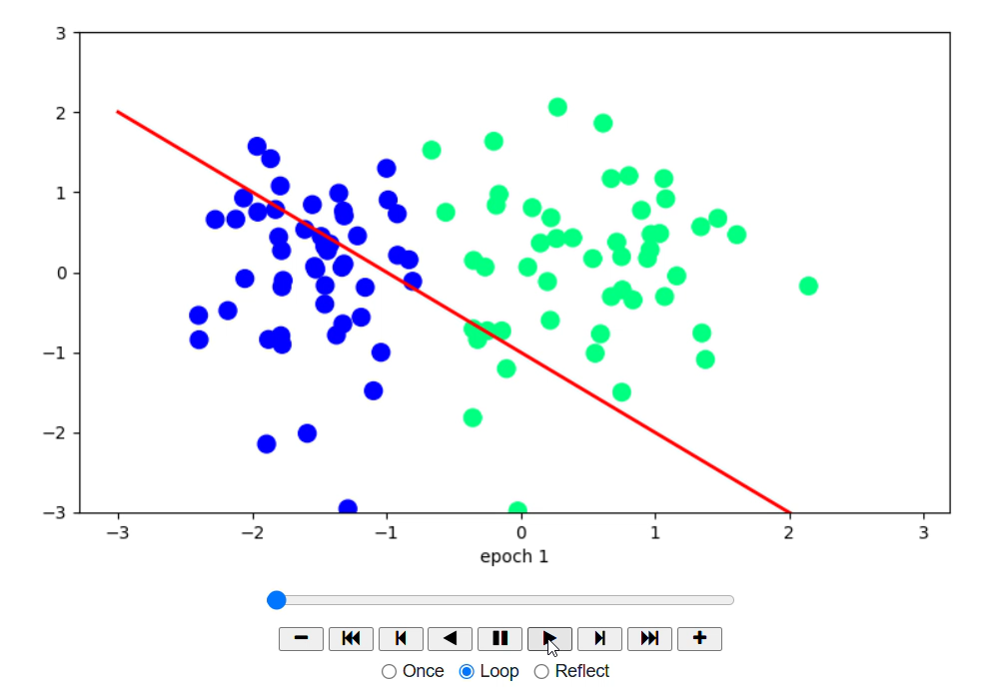
Visualising Decision Boundary as a binary classifier

Slide 25
Linear Separability
A dataset is linearly separable if one linear boundary can separate its classes without error. A single perceptron can correctly classify all the data points if such a boundary exists.
Why it matters
The perceptron convergence guarantee depends on linear separability and the algorithm's standard assumptions.
x₂
x₂
x₁
x₁
AND ✓
x₁ + x₂ − 1.5 = 0
OR ✓
x₁ + x₂ − 0.5 = 0
Both are linearly separable.

Slide 26
Limitations

Slide 27
Non-Linearly Separable Data
x₁ | x₂ | XOR
0 | 0 | 0
0 | 1 | 1
1 | 0 | 1
1 | 1 | 0
Definition: Datasets requiring curved, circular, or multi-segment boundaries to separate classes.
Perceptron Failure: Single perceptron CANNOT converge; boundary oscillates indefinitely without solving problem.
Examples: XOR logic gate, concentric circle clusters, complex real-world image/text data.
x₂
1. XOR Problem
XOR is 1 when the inputs differ and 0 when they are equal. No single line separates the two classes.
This is a representational limit, not a training problem
(0,1)
(1,1)
(0,0)
(1,0)
x₁

Slide 28
Other Limitations
2
Hard threshold
3
Limited capacity
Abrupt output, no continuous probability-like score.
One threshold unit cannot model every relationship.
4
Order of examples
5
Generalization
Presentation order shapes the boundary found.
Fitting training data does not ensure unseen accuracy.

Slide 29
Overcoming the Limitations
1
Multilayer perceptrons
2
Nonlinear activations
Hidden layers plus nonlinear activations can form nonlinear boundaries, including XOR.
ReLU, sigmoid, tanh. Stacked linear layers alone stay linear.
3
Feature engineering
4
Other classifiers
A good input transformation can make classes linearly separable.
Kernel SVMs, decision trees, random forests or neural networks, depending on the task.

Slide 30
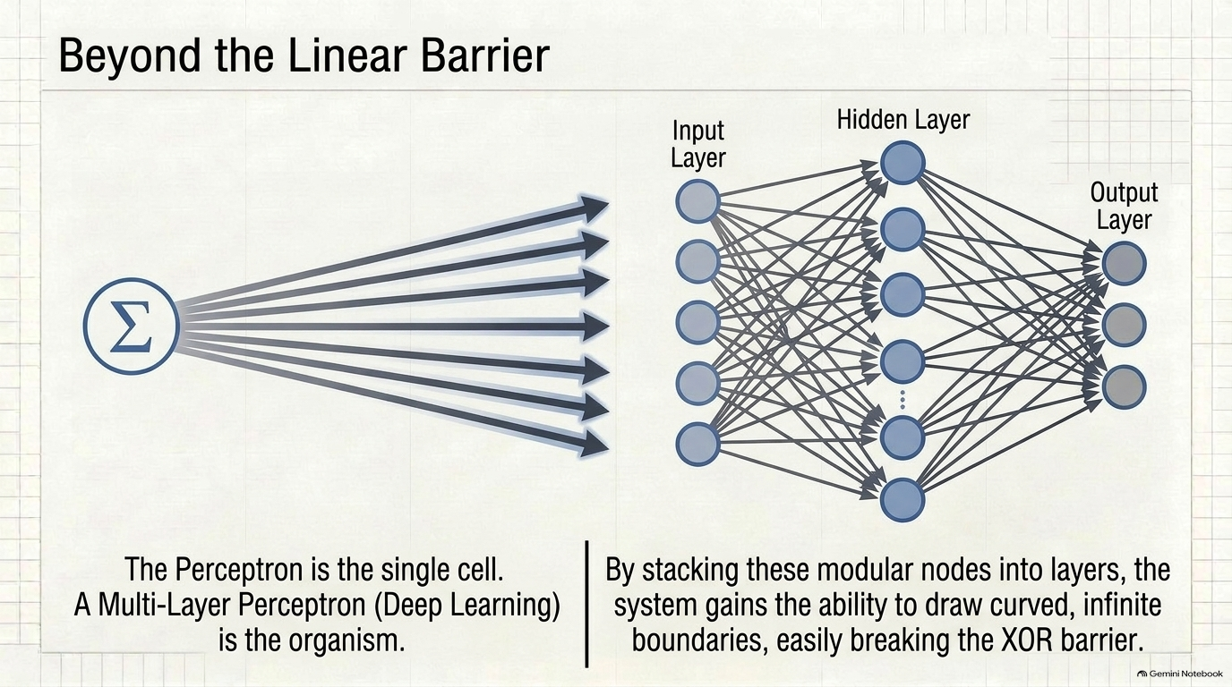

Slide 31
Applications
1
Perceptron as a Binary Classifier
A perceptron can classify input patterns into different categories based on their features. It works correctly when the classes are linearly separable.
2
Boolean functions
A perceptron can implement basic Boolean functions such as AND and OR. It produces a binary output of 0 or 1 depending on the input values
3
Simple binary decisions
4
Educational foundation
A perceptron can make yes/no decisions using weighted input features and a bias.
weights, bias, activations, supervised learning, boundaries

Slide 32
References
1
S. N. Deepa and S. N. Sivanandam,” Principles of Soft Computing”, 2nd Edition, Wiley, 2011.
2
S. Rajasekaran, G. A. Vijayalakshmi Pai, “Neural Networks, Fuzzy Logic and Genetic Algorithms : Synthesis and Applications”, 1st Edition, Prentice Hall of India, 2003.
3
Stanford Lecture
https://share.google/6FupdV0VVW7JuFJSj

